Slide 1
Biomimetic Fish
Abdulrahman Alnebari, Shuaib Alshuaib, James Brooks, Nathan Servis

Slide 2
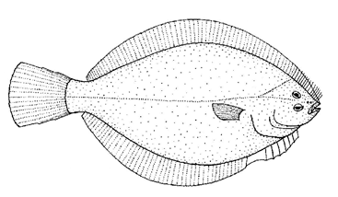
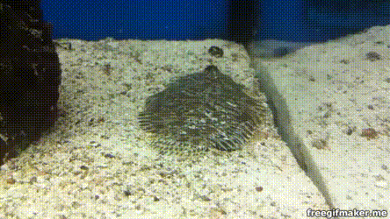
Project Goal and Background
Our Client Dr. Alice Gibbs requested our team to make a device that mimics the burying movement of flatfishes.
The most common types flatfish are the flounder and sole
Sole’s can grow to a size between 2 - 5 lbs while a flounder can grow up to 17 lbs
Flatfish bury themselves in order to ambush prey and hide from predators , they do this by moving their body rapidly up and down.
Typical Flounder
Flounder burying itself
Nathan Servis

Slide 3
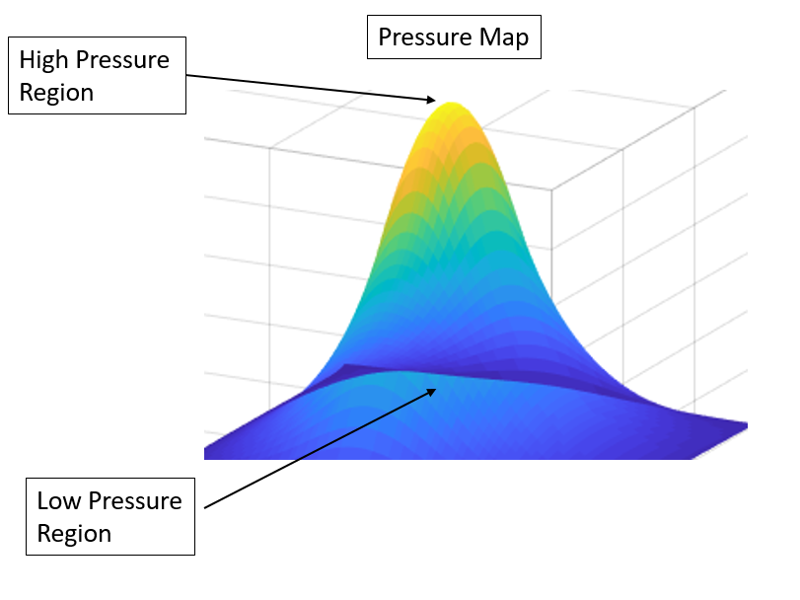
Fluidization
The process fish use to bury themselves under the seabed.
By quickly moving up and down the fish creates a change in pressure that causes sand underneath to move like a fluid.
Sample Displaced on Up-Stroke
James Brooks

Slide 4
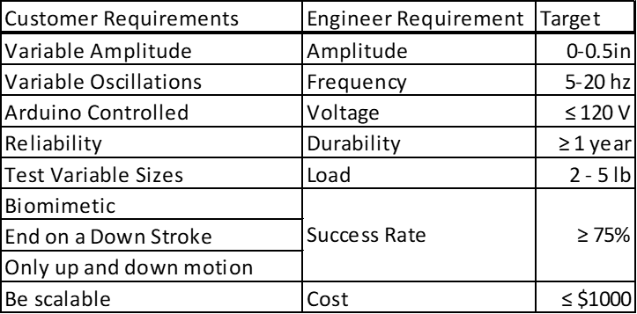
Client Requests and Engineering Requirements
Shuaib Alshuaib
Notes:
Client requirements into measurable objectives

Slide 5
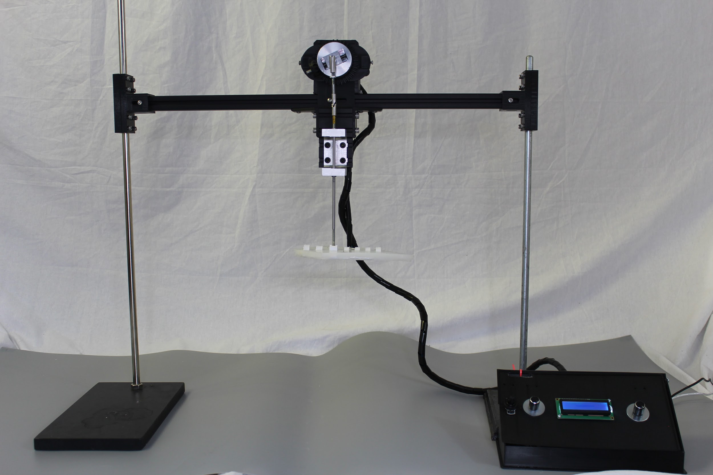
Final Design
Amplitude Adjustment
Crank-Slider
Control System
Abdul Alnebari

Slide 6
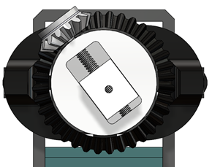
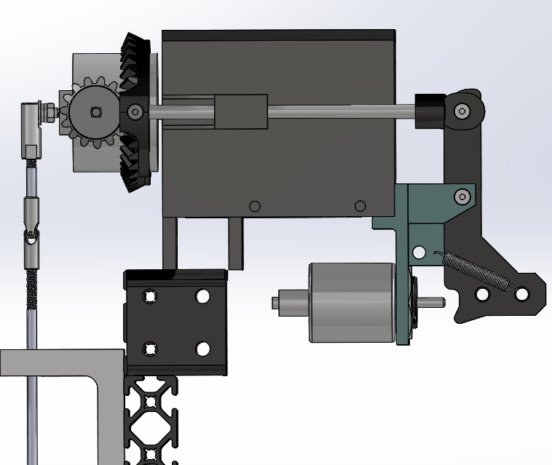
Subsystem 1- Amplitude Adjustment
A lead screw can be adjusted to change amplitude
A 12v solenoid connected to a gear extends to allow automated adjustment
The device can move up to 1 inch
Amplitude Adjustment
Cad Model of Amplitude Adjustment
James Brooks

Slide 7
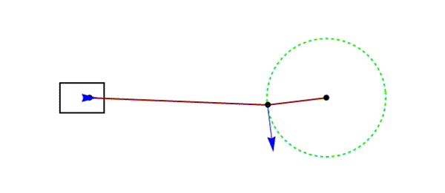
Subsystem 2- Crank Slider
Allows conversion of rotational motion into linear.
Needs a custom machined rod holder to ensure perfect linear motion
The motor used can generate up to 35 hz ( 2100 RPM ) and a max torque of 165 in-oz
The force needed to move the motor can be changed based on the amplitude.
Crank-Slider
Cranks Slider Side-by-Side Comparison
Shuaib Alshuaib

Slide 8
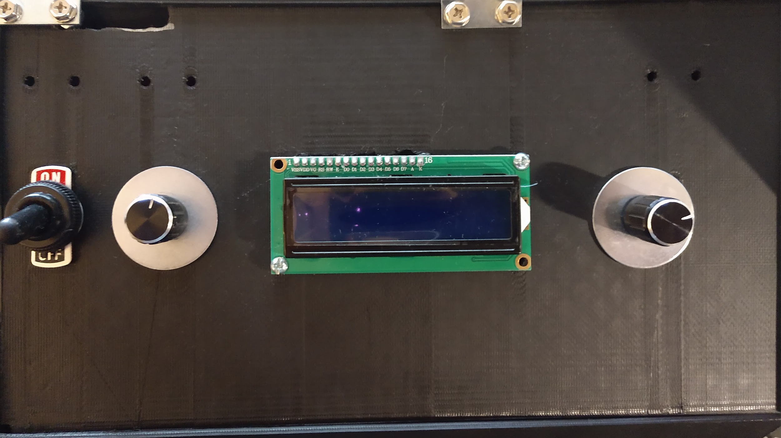
Subsystem 3 - Control Systems
It is controlled via an arduino Mega
The device has a custom built PCB that connects all the wires together.
The Solenoid runs on 12v
The stepper motor runs on 20v but is upgradeable to 48v
The system has 3 controls
  Solenoid switch
  Brightness knob
  Control knob
Solenoid Switch
Brightness Knob
Control Knob
Solenoid Switch
Brightness Knob
Control Knob
Control System
Nathan Servis

Slide 9
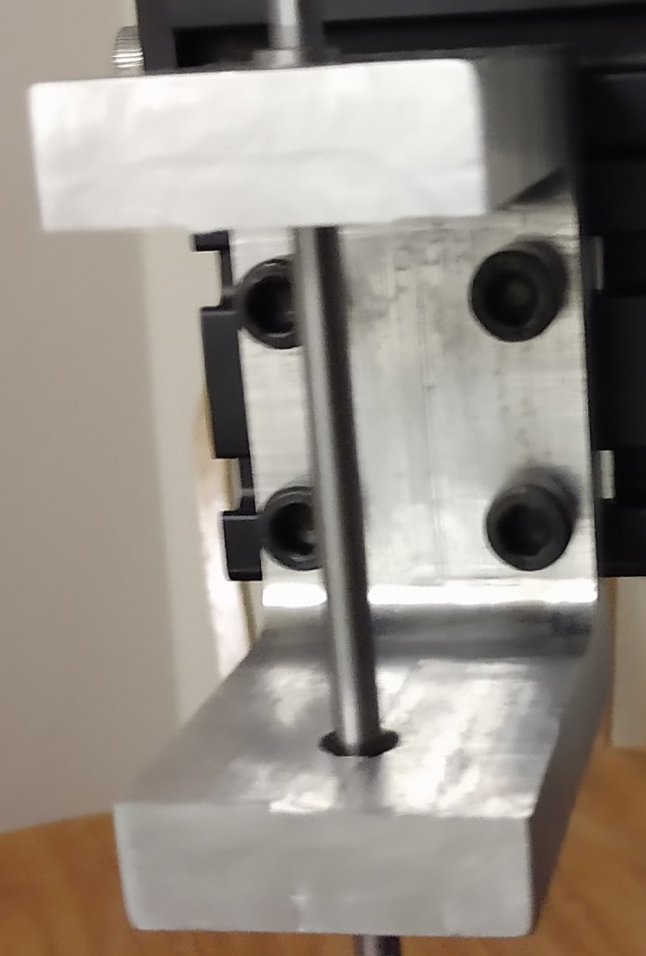
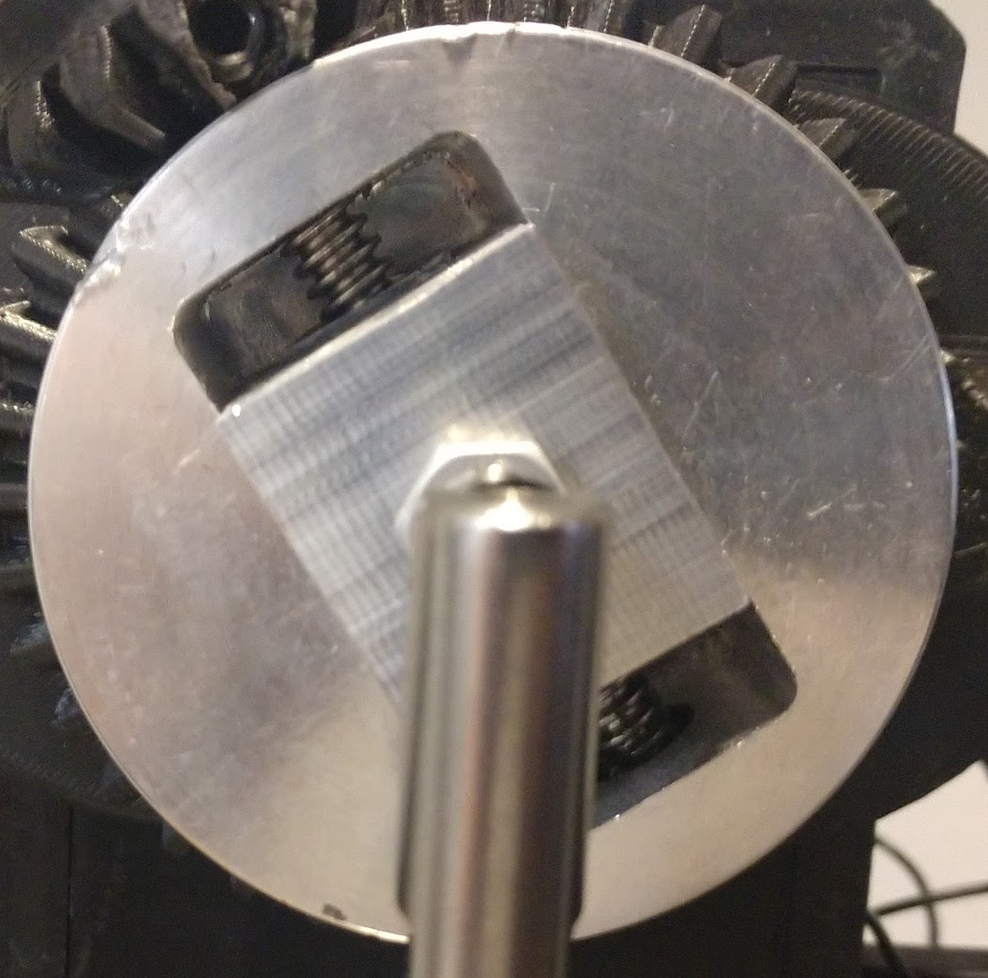
Manufacturing: Machining
There are three parts machined
  Motor Hub
  Movable Pin
  Lower Bushing Mount
Machined at the NAU machine shop
They’re made of aluminum in order to be more rigid and durable.
Lower Bushing Mount
Motor Hub
Movable Pin
Abdul Alnebari
Notes:
While not all of are parts are machined these three components are
They’re the Motor hub, Movable Pin and Lower bushing mounts
Originally these parts were 3D printed but were wearing out too fast due to the vibrations in the machine
We made them out of aluminum as it is a rigid durable material.

Slide 10
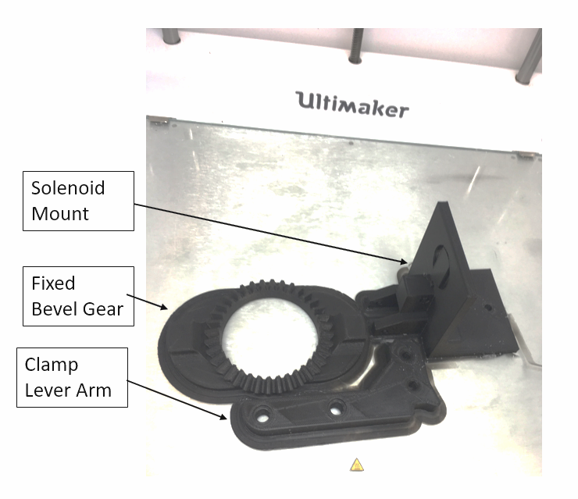
Manufacturing: 3D Printing
Difficult to machine
The ring stand mounts, motor casing, and gears were all made of 3D printed PLA
PLA:
Does not shrink much while cooling
Quicker lead times
Readily available
All parts were printed thanks to POBA Medical
Amplitude Adjustment Components
James Brooks

Slide 11
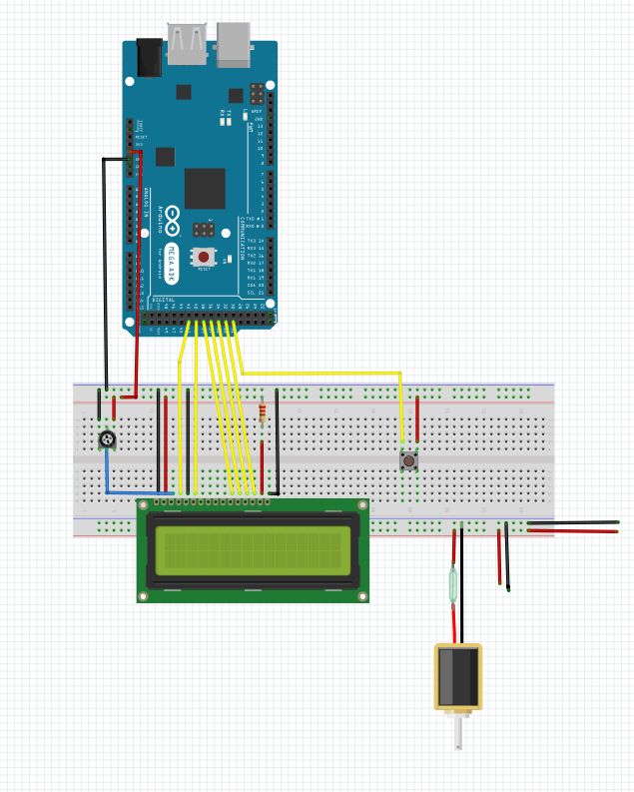
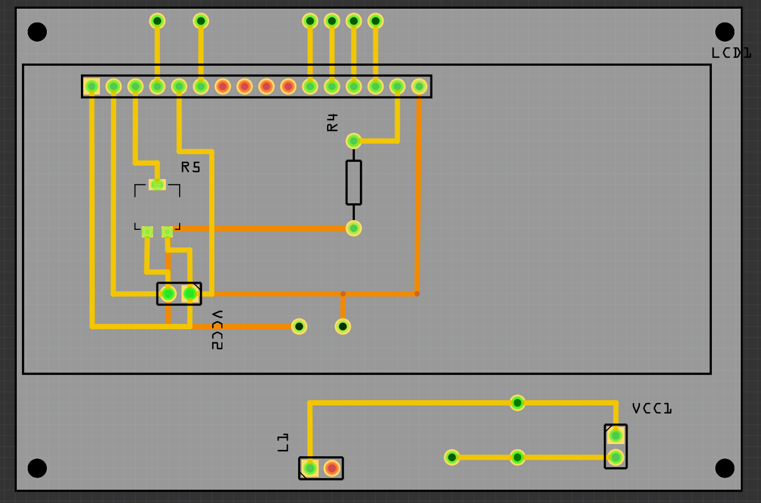
Manufacturing: Circuitry
A custom PCB was designed using fritzing.
The device was made through their partner company Aisler.
The circuit was soldered by hand in the MakerLab.
Organized PCB
Schematic of Electronics
Nathan Servis

Slide 12
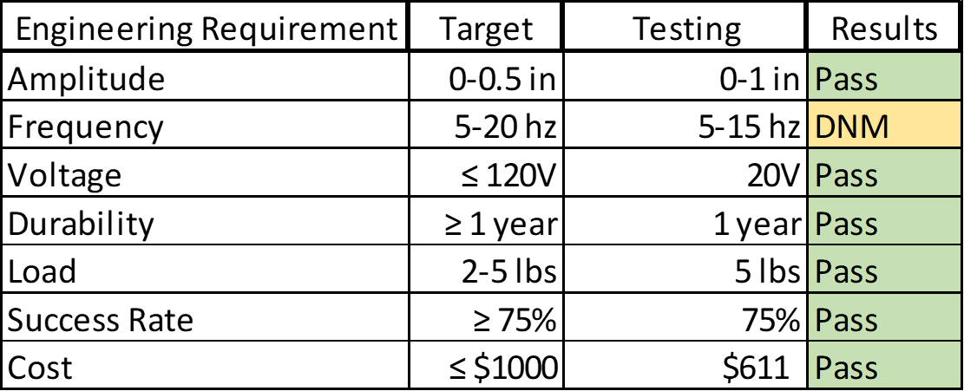
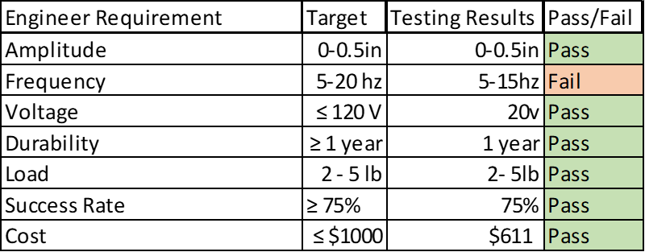
Testing
Abdul Alnebari
Notes:
0-1inch
DNM (did not meet)
The amplitude adjustment passed as the motor is able to operate at all amplitudes
The voltage requirement is a pass, as the device can plug directly into a wall
The durability and load requirements pass, as the device survived all testing
The success rate passed as the device ended on a downstroke reliably
And the device is manufacturable at a cost lower than anticipated
However, the frequency was not able to reach 20Hz,

Slide 13
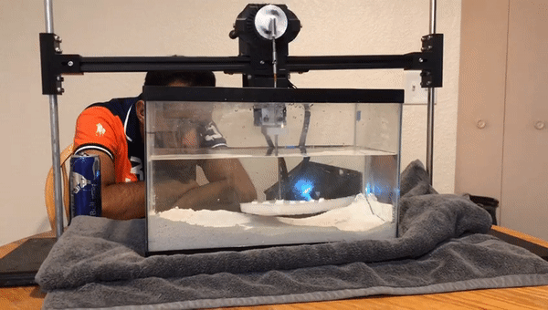
Testing: Variable RPM
The device is able to go from 0 to 15 hz (900 rpm) reliably.
The device is not able to meet the max requested speed but the team has a solution to get to higher speeds.
By increasing the voltage to the motor the required RPM can be achieved
The motor is able to produce enough torque to move the sample.
The light-weight motor head allows samples to end on a downstroke, ensuring the device gets buried.
Oscillation Test of Device
Shuaib Alshuaib

Slide 14
Testing: Amplitude Adjustment
The device is able to move between 0 and 1 inch in amplitude
The team ran the device 25 times at incremental-amplitude-intervals to ensure it meets all requirements
The device doesn’t interference with the gears when not extended.
Cad Model of Amplitude Adjustment
James Brooks

Slide 15
Conclusion
The device is capable of burying samples.
It has variable amplitude and oscillations
The oscillation doesn’t reach the max but the team has a solution put in place to reach
The device will help our client research ways to improve underwater technologies
Final Device Design
Nathan Servis

Slide 16
Questions?

